Slide 1


Slide 2

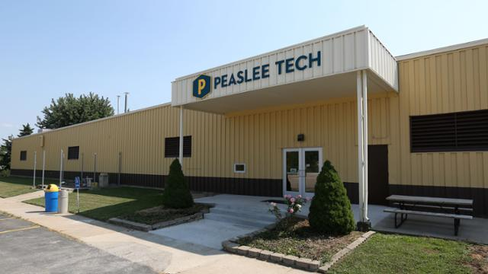

Slide 3
Mission
We are a catalyst for economic growth
providing technical training to a
diverse community of learners to meet
the current and emerging needs of our
communities and employers.
Vision
We envision a community with a
technically skilled workforce that
fosters retention, expansion, and
attraction of business.
Values
We value empowering diverse individuals, collaborating
across the community,
and cultivating innovation and entrepreneurship..

Slide 4
NEW PROGRAMS IN 2017
AUTO DRIVERS TRAINING
CISCO CCNA Routing and Switching
PROFESSIONAL DRIVING
INTRODUCTION TO MANUFACTURING
OSHA TRAINING
PHARMACY TECHNICIAN
INDUSTRIAL MAINTENANCE MECHANIC APPRENTICESHIP

Slide 5
NEW PROGRAMS IN 2018
Facilities Maintenance Apprenticeship (multi-family)
Residential Electrician Apprenticeship
Residential Plumber Apprenticeship
Carpentry
Certified Voice Writer

Slide 6
NEW PROGRAMS IN 2019
Facilities Maintenance Apprenticeship\Open Enrollment (commercial)
Sterile Processing Apprenticeship
Medical Assistant Apprenticeship
Dental Assistant Apprenticeship
Computer Networking Apprenticeship
Residential HVAC Apprenticeship/Open Enrollment
Auto Repair Technician Apprenticeship/Open Enrollment
Auto Body Repair Technician Apprenticeship/Open Enrollment
Welding (NCCC)

Slide 7



Slide 8
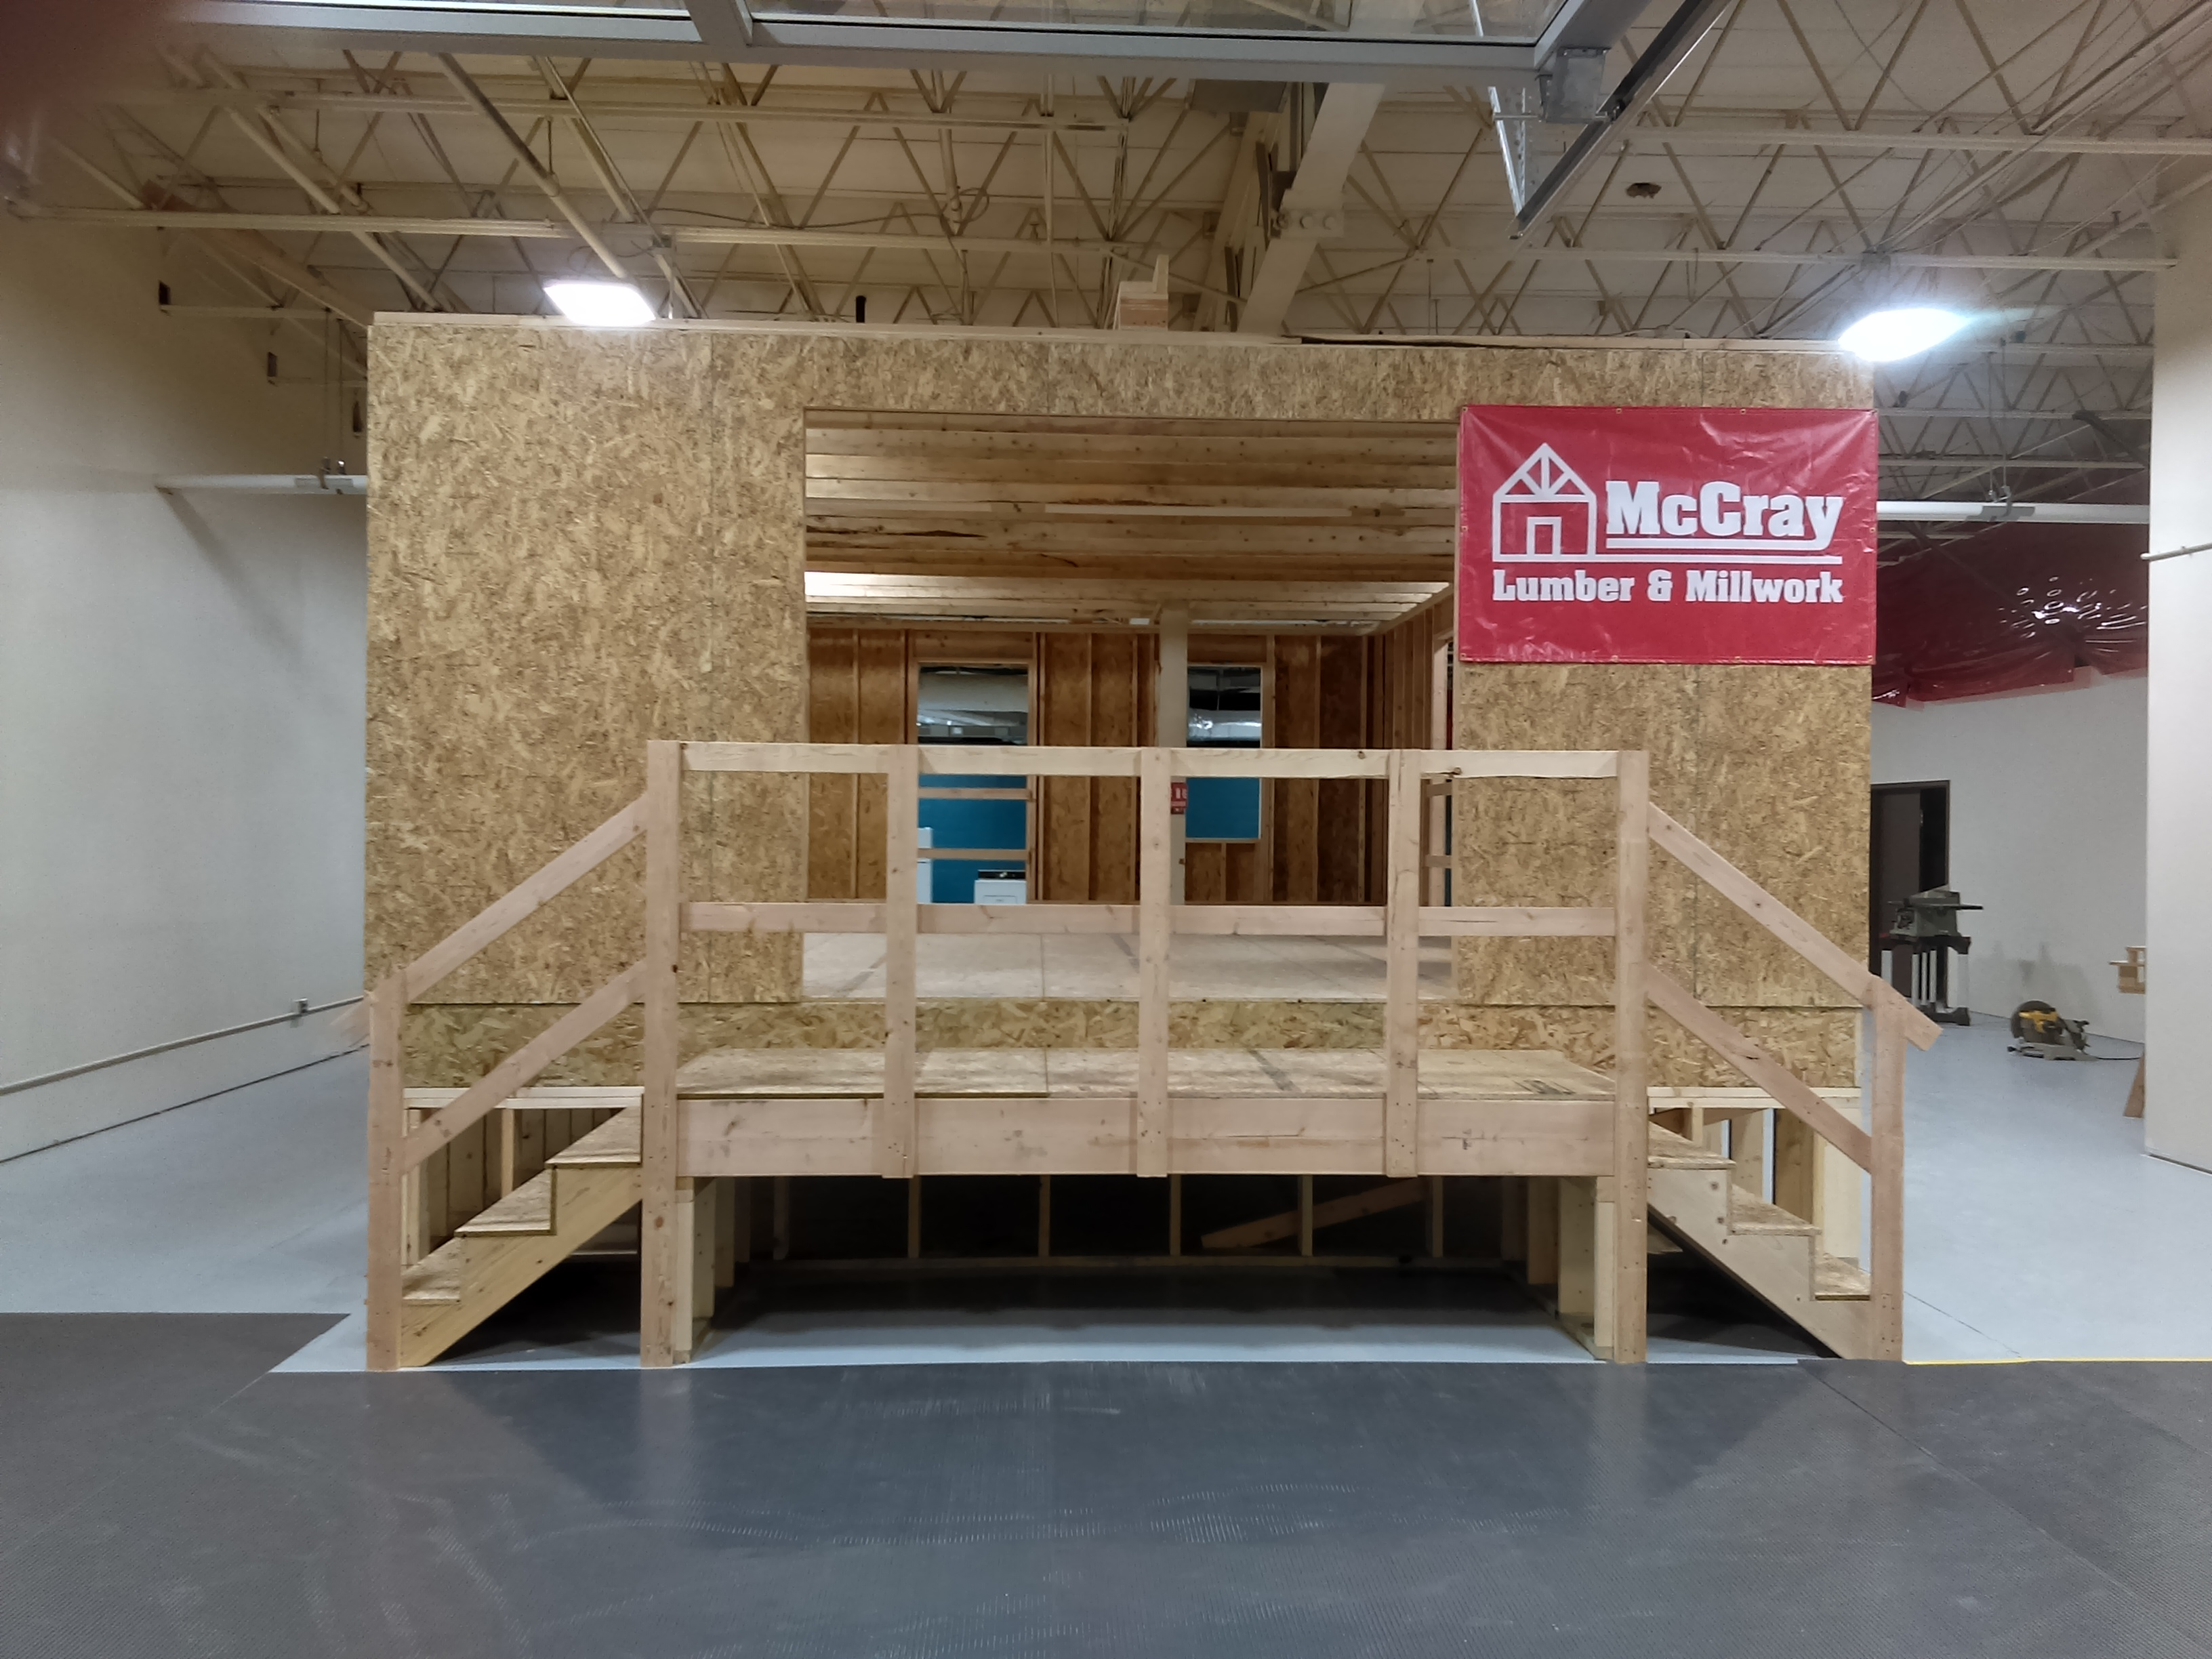

Slide 9
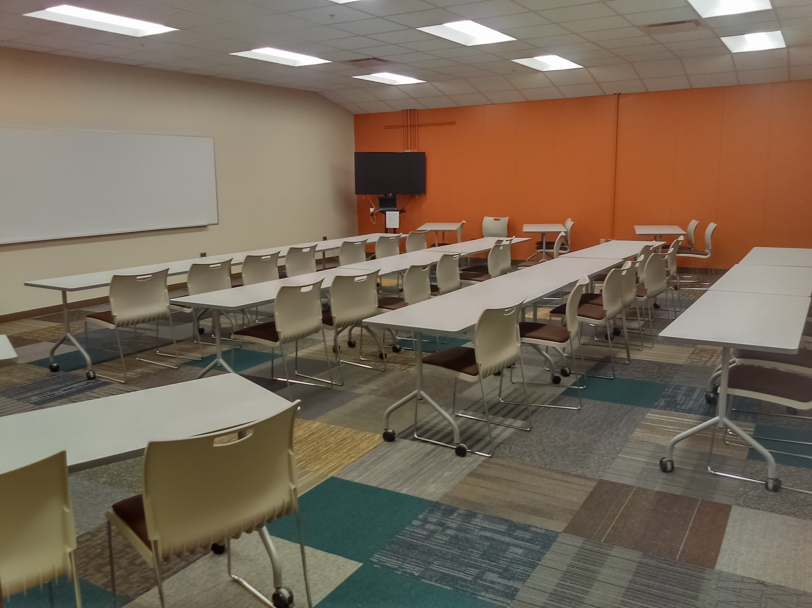

Slide 10
Industrial Maintenance
Laboratory

Slide 11
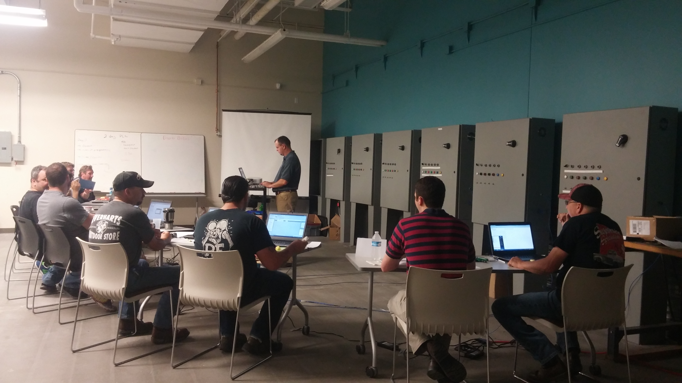

Slide 12
Machining Laboratory

Slide 13
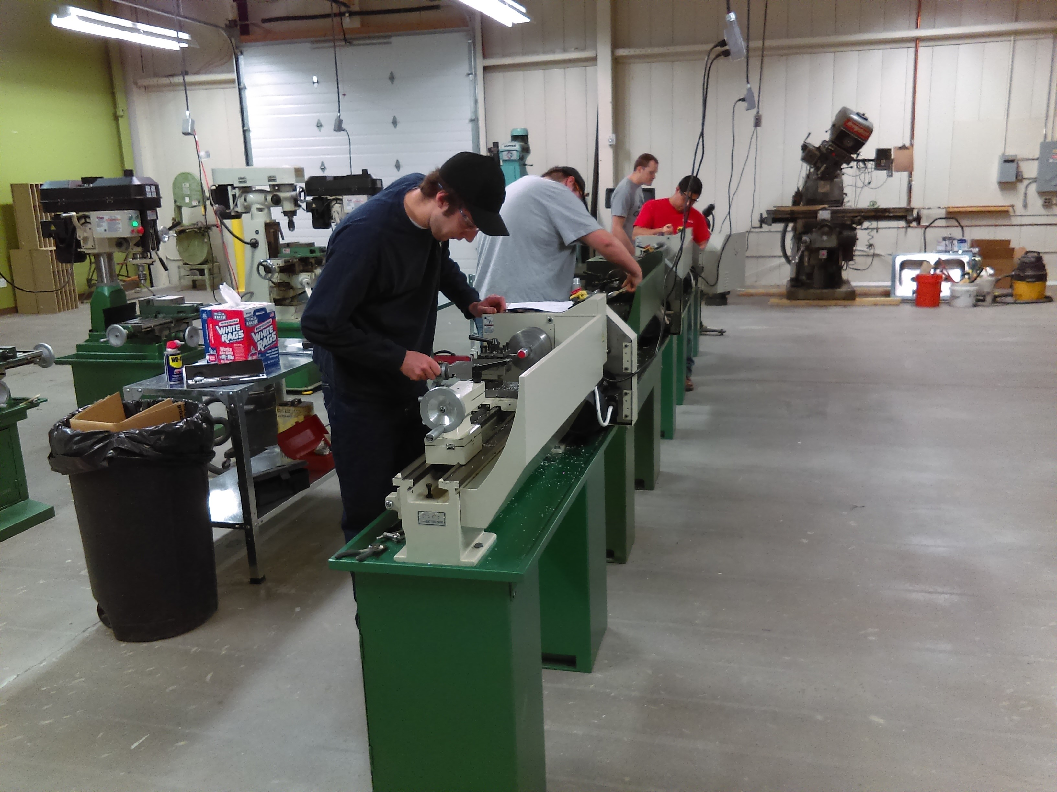

Slide 14
Lawrence New Car Dealers Laboratory

Slide 15
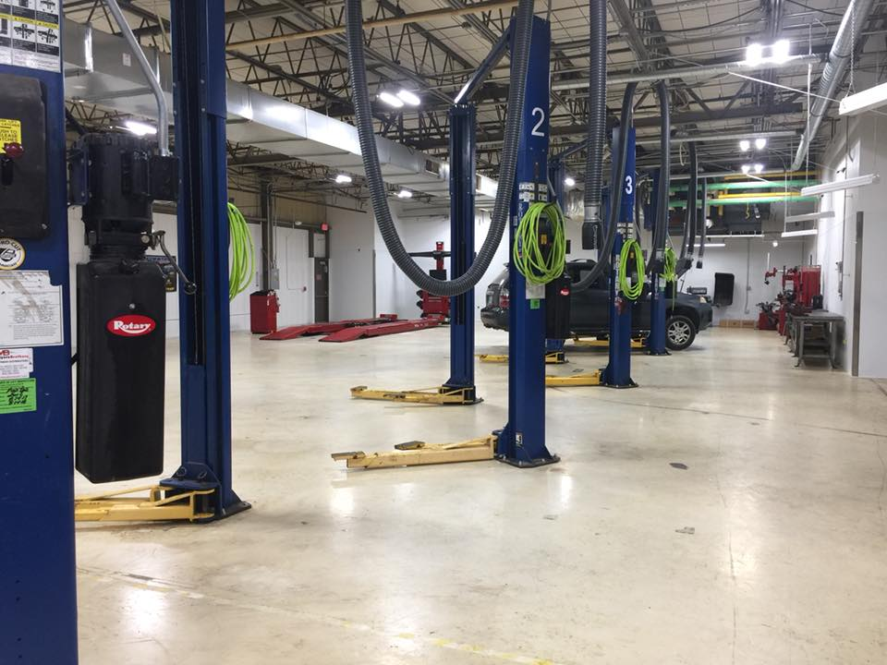

Slide 16
Welding Laboratory

Slide 17
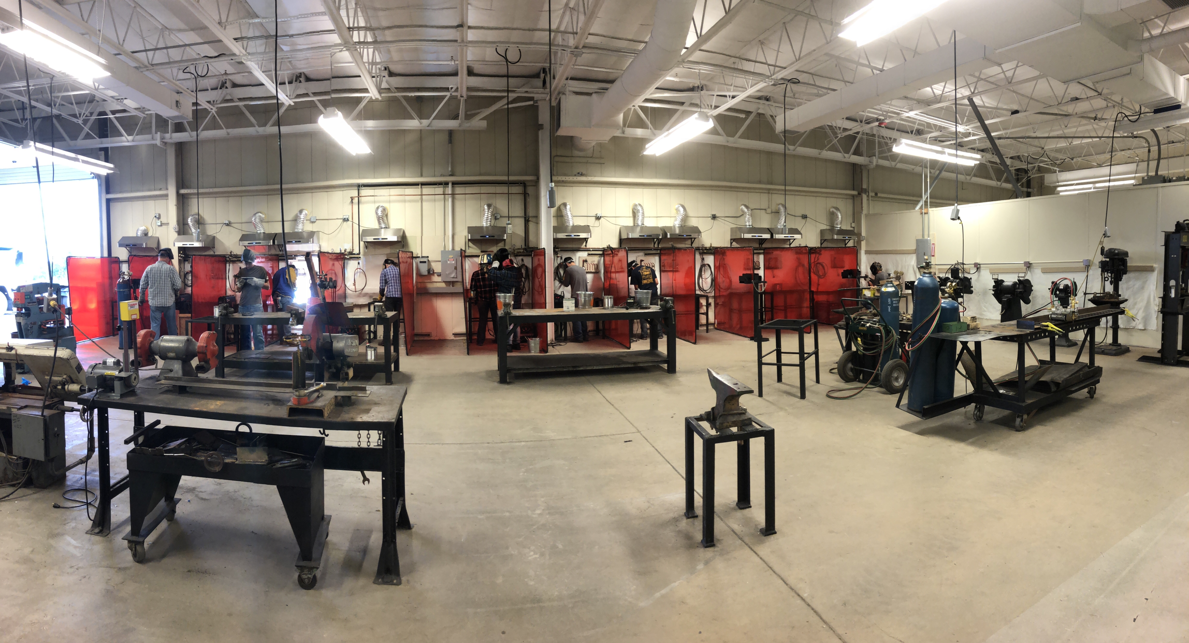

Slide 18
Networking and Computing Laboratories

Slide 19
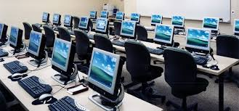

Slide 20
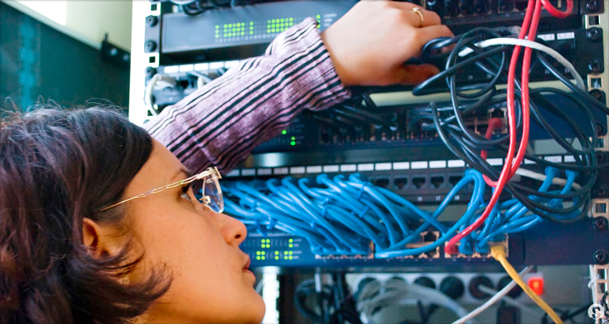

Slide 21

Kevin W. Kelley, Ph.D.
Kevin.kelley@peasleetech.org
(785) 856-1801

