Slide 1


Slide 2

The Dwayne Peaslee Technical Training Center
Welcome to
CDL Pre Behind-the-Wheel Training Course
December 2024

Slide 3
What You Will Learn In This Course
How to properly conduct a Pre-trip Inspection
How to perform an External Light Check
How to perform a “Connections” inspection
How to perform an In-Cab Inspection with Brake Check

Slide 4
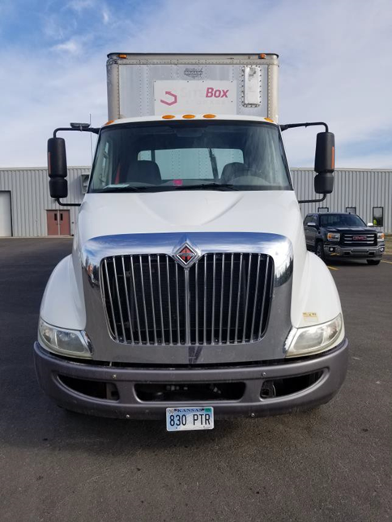
External Light Check
Front of Truck.
Clearance, headlights, high beams, left turn, right turn, 4-way ﬂashers.
Left Side of Truck.
Clearance, left turn, 4-way ﬂashers.
Back of Truck.
Brake lights, taillights, left turn, right turn, 4-way ﬂashers.
Right Side of Truck.
Clearance, right turn, 4-way ﬂashers.

Slide 5
External Light Check
Front of Trailer.
Clearance lights.
Left Side of Trailer.
Clearance, left turn, 4-way ﬂashers.
Back of Trailer.
Clearance, brake lights, taillights, left turn, right turn, 4-way ﬂashers.
Right Side of Trailer.
Clearance, right turn, 4-way ﬂashers.

Slide 6
In-Cab Inspection with Brake Check
Brake Check (5).
IMPORTANT: explain each step in the brake check BEFORE performing the step.
Air compressor test:
THE ENGINE HAS REACHED 120-140PSI AND THE GOVERNOR HAS CUT OUT
(you’ll hear air release after the cut out)
Note: Turn the engine off. Turn the key on for the last 3 steps. This simple step will save an automatic failure.

Slide 7
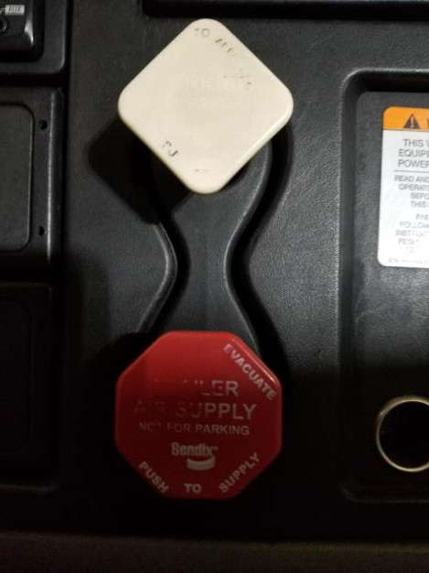
In-Cab Inspection with Brake Check
Brakes Applied Test:
I WILL PUT THE TRUCK IN GEAR, TURN THE ENGINE OFF. THEN I WILL RELEASE THE CLUTCH AND TURN THE KEY ON. I WILL THEN RELEASE THE AIR VALVES AND PRESS THE BRAKE PEDAL DOWN AND HOLD IT. WHEN THE PRESSURE HAS STABILIZED, I WILL START THE TIMER. THE AIR GAUGES CANNOT LOSE MORE THAN 4PSI IN 1 MINUTE
AT THE END OF THE BRAKE TEST
THE AIR PRESSURE DID NOT LOSE MORE THAN 4PSI IN 1 MINUTE
Low Air Warning:
WITH THE ENGINE OFF, THE KEY ON, AND THE AIR VALVES PUSHED-IN, I WILL FAN THE BRAKE PEDAL UNTIL THE AIR GAUGE READS 60 PSI AT WHICH POINT THE LOW-AIR LIGHT AND BUZZER SHOULD COME ON
AT THE END OF THE LOW AIR WARNING TEST
THE LOW AIR WARNING LIGHT AND BUZZER CAME ON AT 60PSI
11

Slide 8
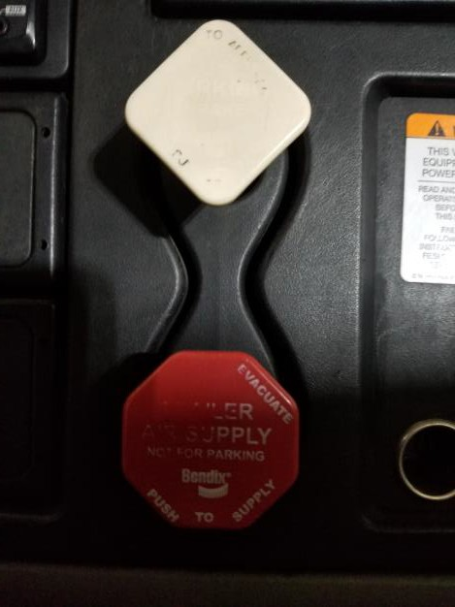
In-Cab Inspection with Brake Check
EMERGENCY SPRING BRAKE (POP-OUT) TEST
WITH THE ENGINE OFF, THE KEY ON, AND THE AIR VALVES ARE PUSHED-IN. I WILL FAN THE BRAKES UNTIL THE AIR PRESSURE REACHES 40-20PSI, AT WHICH TIME THE BRAKE VALVES SHOULD POP OUT ON THEIR OWN
AFTER EMERGENCY SPRING BRAKE TEST
THE EMERGENCY SPRING BRAKES POPPED OUT BETWEEN 40 AND 20PSI

Slide 9

In-Cab Inspection with Brake Check
Safe Start
Parking brake is set, transmission in neutral, and clutch depressed. Start engine and look for ABS light to come on then go oﬀ.
PARKING BRAKE TEST
I WILL START THE TRUCK AND LET THE AIR PRESSURE BUILD TO A SAFE OPERATING LEVEL. I WILL THEN RELEASE THE TRAILER BRAKE AND TUG LIGHTLY AGAINST IT.
AFTER THE PARKING BRAKE TEST
THE PARKING BRAKE TEST HAS BEEN PASSED

Slide 10

In-Cab Inspection with Brake Check
SERVICE BRAKE TEST
I WILL RELEASE THE PARKING BRAKE BY PUSHING BOTH VALVES IN AND PULL FORWARD TO 5 MPH, DEPRESS THE CLUTCH AND BRAKE WHILE GRIPPING THE STEERING WHEEL TO CHECK IF THE VEHICLE PULLS TO THE LEFT OR THE RIGHT
AFTER THE SERVICE BRAKE TEST
THIS CONCLUDES MY IN-CAB WITH SERVICE BRAKE CHECK TEST

Slide 11
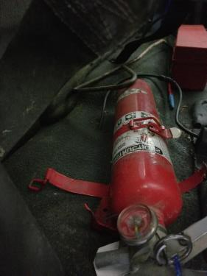
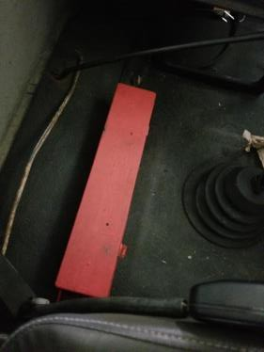
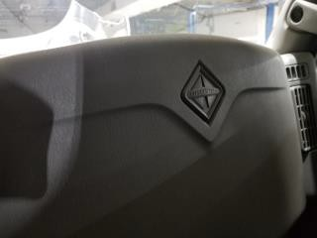
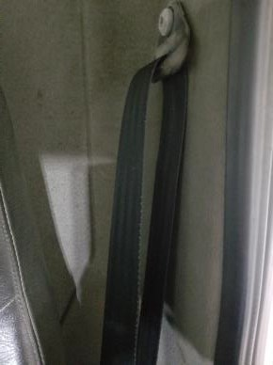
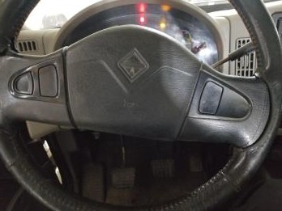
In-Cab Inspection with Brake Check
Point to, or touch, every item that you are inspecting. Tell the tester how you know that the part you are inspecting is in good, safe working condition. Identify all defects or you may not receive credit. Say exactly the words as written below.
Safety Items (5).
BEFORE ENTERING THE TRUCK, VERIFY THE FIRE EXTINGUISHER IS SECURELY MOUNTED. IT IS PROPERLY CHARGED AND RATED
THE THREE TRIANGLES ARE SECURELY MOUNTED. THEY ARE NOT BROKEN OR CRACKED
THE SPARE FUSES ARE PRESENT
THE SEAT BELT IS SECURELY MOUNTED. THE BELT LATCHES AND UNLATCHES, ADJUSTS PROPERLY AND IS NOT CUT OR FRAYED
THE AIR AND ELECTRIC HORNS WORK PROPERLY

Slide 12
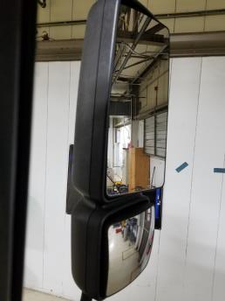
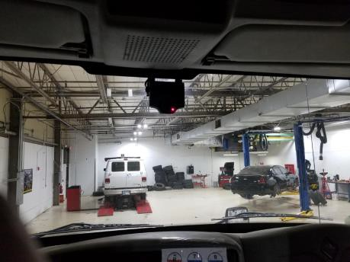
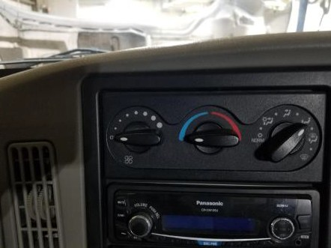
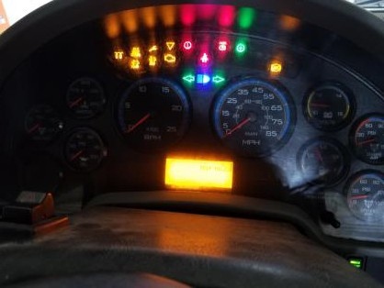
In-Cab Inspection with Brake Check
KEY ON, ENGINE ON
In-Cab Items (5).
THE MIRRORS ARE CLEAN, NOT CRACKED, PROPERLY ADJUSTED AND THERE ARE NO ILLEGAL STICKERS
THE WINDSHIELD IS SECURELY MOUNTED, NOT BROKEN AND THERE ARE NO ILLEGAL STICKERS
THE WIPER ARMS AND BLADES ARE SECURELY MOUNTED AND HAVE NO CRACKS, LEAKS OR SPLITS. THE WIPER FLUID IS WORKING PROPERLY ON HIGH, LOW, AND FLUID
THE HEATER AND DEFROSTER BOTH WORK PROPERLY
THE DASHBOARD INDICATOR LIGHTS, LEFT AND RIGHT TURN SIGNALS, 4-WAY FLASHERS, AND HIGH BEAMS ARE WORKING PROPERLY

Slide 13

Pre-Trip Inspection
Starting at the front of the truck, top to bottom. Pointing at the items say these phrases
THE MARKER LIGHTS ARE THE PROPER COLOR, YELLOW OR AMBER, AND NOT CRACKED, BROKEN, OR DIRTY
THE HEADLIGHTS ARE THE PROPER COLOR, CLEAR, AND NOT CRACKED, BROKEN, OR DIRTY
THE TRUCK IS NOT LEANING, MEANING THERE ARE NO SUSPENSION
OR TIRE PRESSURE ISSUES
THE LOWER RADIATOR HOSE IS PROPERLY MOUNTED, NOT LEAKING AND ALL HARDWARE PRESENT

Slide 14
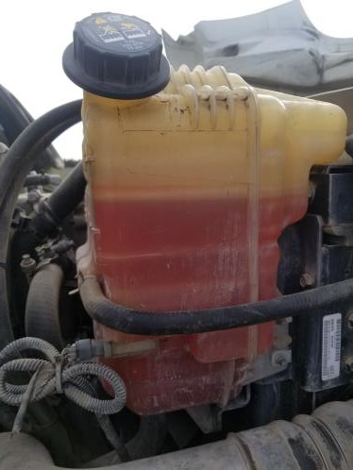
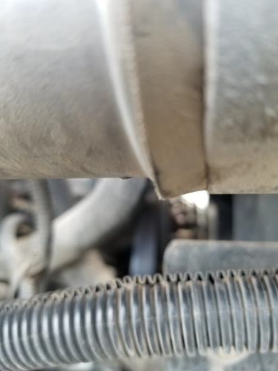
Pre-Trip Inspection
With the hood open, from the passenger side of the truck, pointing at the items say these phrases
THE COOLANT RESERVOIR IS AT THE PROPER LEVEL, SECURELY MOUNTED, AND NOT LEAKING. THE HOSE IS NOT DAMAGED OR LEAKING AND IS SECURELY MOUNTED.
THE WATER PUMP IS SECURELY MOUNTED AND NOT DAMAGED, NOT LEAKING AND IS BELT DRIVEN. THE BELT IS NOT CUT OR DAMAGED AND HAS NO LESS THAN ½” OF PLAY AND NO MORE THAN ¾” OF PLAY

Slide 15
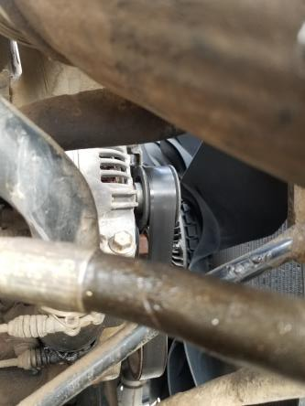
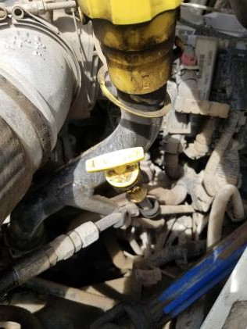
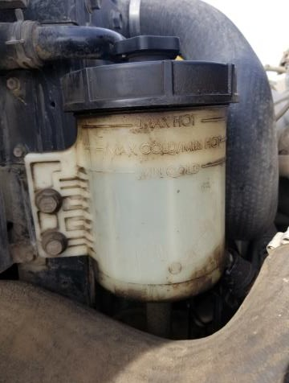
Pre-Trip Inspection
With the hood open, from the driver’s side of the truck,
pointing at the items say these phrases
TO CHECK THE OIL LEVEL, REMOVE THE DIPSTICK WIPE CLEAN, RE- INSERT, REMOVE AND CHECK THE OIL LEVEL. LEVEL MUST AT, OR BELOW FULL, BUT ABOVE ADD
THIS IS THE POWER STEERING RESERVOIR DIPSTICK. THE RESERVOIR IS AT THE PROPER LEVEL, NOT LEAKING AND IS SECURELY MOUNTED. THE HOSE HAS NO SPLITS OR CUTS, IS SECURELY MOUNTED AT BOTH ENDS, AND DOES NOT LEAK

Slide 16
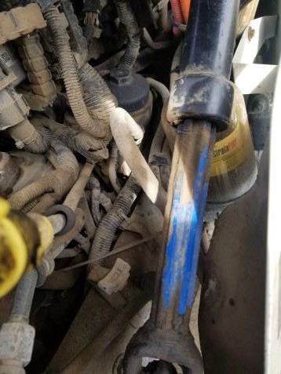
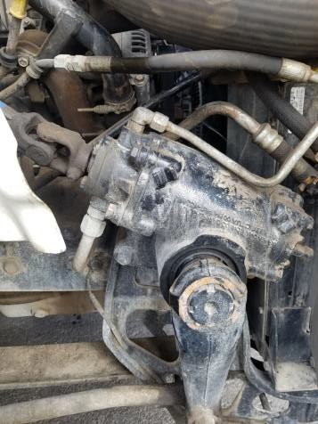
Pre-Trip Inspection
With the hood open, from the driver’s side of the truck,
pointing at the items say these phrases
THE AIR COMPRESSOR IS GEAR DRIVEN AND IS SECURELY MOUNTED
AND NOT DAMAGED. THERE ARE NO AUDIBLE LEAKS (not visible, point to the rear of the engine)
THE POWER STEERING PUMP IS SECURELY MOUNTED AND NOT DAMAGED. THERE ARE NO LEAKS ON THE GROUND
THE STEERING SHAFT IS SECURELY MOUNTED AND NOT CRACKED OR
BROKEN AND HAS NO EXCESSIVE PLAY
THE POWER STEERING BOX IS SECURELY MOUNTED TO THE FRAME AND NOT DAMAGED. ALL HARDWARE IS PRESENT AND THERE ARE NO LEAKS

Slide 17
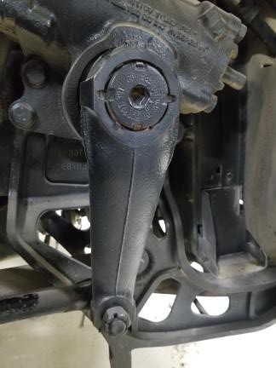
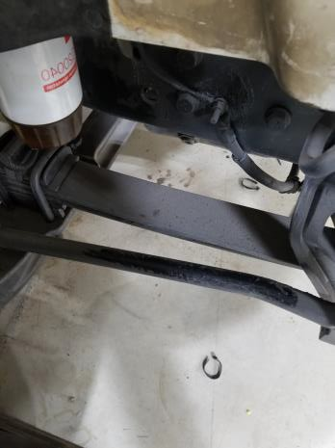
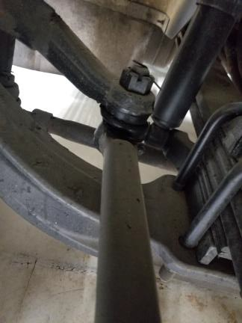
Pre-Trip Inspection
With the hood open, from the driver’s side of the truck,
pointing at the items say these phrases
THE PITMAN ARM IS SECURELY MOUNTED, AND NOT CRACKED OR BROKEN. THE CASTLE NUTS AND COTTER PINS ARE PRESENT AND NOT DAMAGED
THE DRAG LINK IS PROPERLY SECURE AND NOT BROKEN OR CRACKED. THE RUBBER BUSHINGS HAVE NO DAMAGE
THE UPPER AND LOWER CONTROL ARMS AND TIE ROD ARE NOT BENT OR BROKEN AND ALL HARDWARE IS PRESENT AND SECURELY MOUNTED

Slide 18
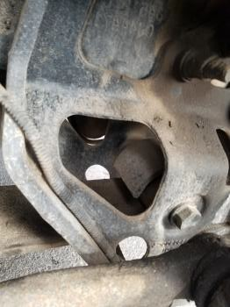
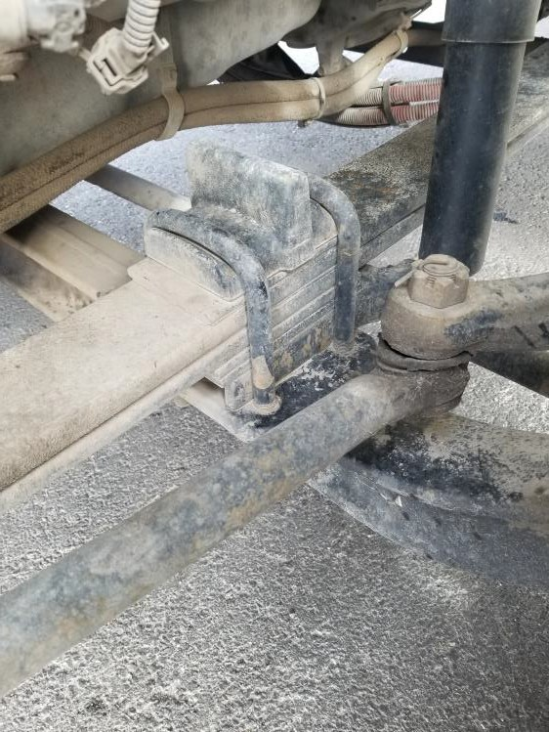
Pre-Trip Inspection
With the hood open, from the driver’s side of the truck,
pointing at the item say these phrases
THE FRONT AND REAR SPRING MOUNTS ARE SECURELY MOUNTED TO THE FRAME AND ARE NOT DAMAGED
THE LEAF SPRINGS ARE NOT CRACKED, BROKEN, SCISSORING, OR
MISSING
THE U-BOLTS ARE NOT BROKEN, CRACKED, LOOSE OR MISSING

Slide 19
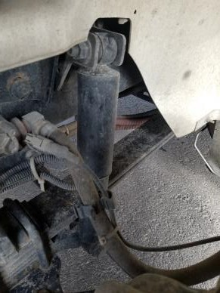
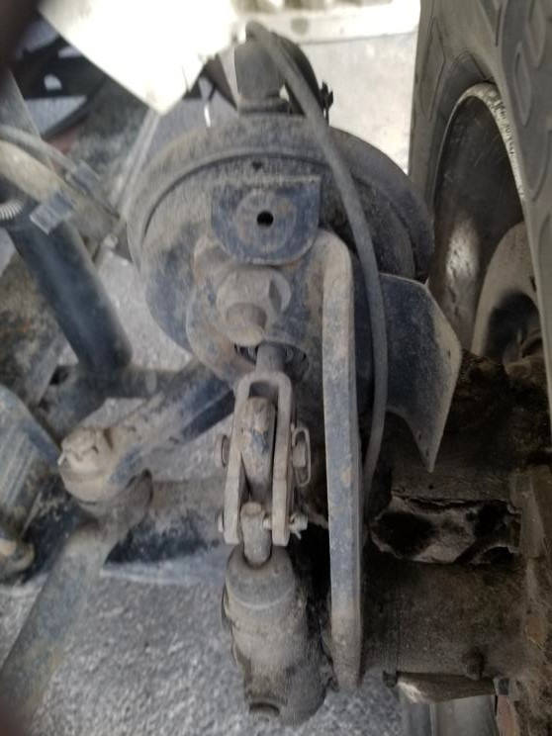
Pre-Trip Inspection
With the hood open, from the driver’s side of the truck,
pointing at the items say these phrases
THE SHOCK ABSORBERS ARE SECURELY MOUNTED AND NOT LEAKING. THE RUBBER BUSHINGS ARE NOT WORN
THE AIR HOSE TO THE BRAKE CHAMBER IS SECURELY MOUNTED ON BOTH ENDS. THERE ARE NO SPLITS OR CUTS AND IS NOT LEAKING
THE BRAKE CHAMBER IS SECURELY MOUNTED. IT IS NOT CRACKED OR BROKEN AND HAS NO LEAKS

Slide 20

Pre-Trip Inspection
With the hood open, from the driver’s side of the truck,
pointing at the items say these phrases
THE ABS LINE IS SECURELY MOUNTED AND NOT FRAYED

Slide 21
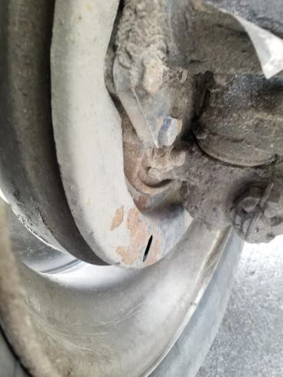
Pre-Trip Inspection
With the hood open, from the driver’s side of the truck,
pointing at the items say these phrases
THE BRAKE PAD IS SECURELY MOUNTED AND NOT BROKEN OR CRACKED. THE PAD MUST HAVE A MINIMUM OF ¼” DEPTH WITH NO SIGNS OF CRACKING, GLAZING, GREASE OR OIL CONTAMINANTS
THE BRAKE DRUM IS SECURELY MOUNTED. IT IS NOT CRACKED OR BENT AND HAS NO BLUEING FROM EXCESSIVE HEAT AND NO GREASE OR OIL CONTAMINANTS

Slide 22
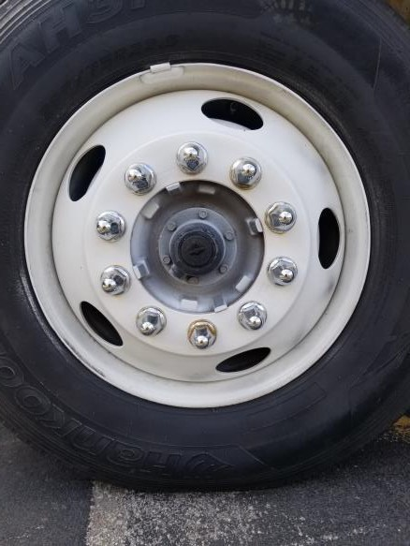
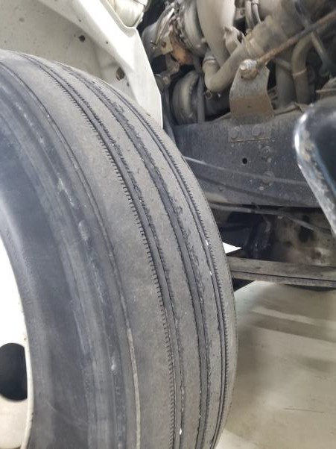
Pre-Trip Inspection
With the hood open, from the driver’s side of the
truck, pointing at the items say these phrases
THE WHEEL IS NOT DAMAGED, CRACKED, OR BENT INSIDE OR OUTSIDE. THERE ARE NO WELDS
CHECK FOR PROPER TIRE INFLATION WITH AN AIR GAUGE
THE TIRE SIDEWALLS HAVE NO SPLITS OR CUTS AND THE TREAD IS EVENLY WORN AND NOT A RETREAD
THE TIRE MUST HAVE A TREAD DEPTH OF AT LEAST 4/32”

Slide 23
Pre-Trip Inspection
With the hood open, from the driver’s side of the
truck, pointing at the items say these phrases
THE VALVE STEM IS SECURELY MOUNTED, NOT DAMAGED AND HAS A METAL CAP
THE LUG NUTS ARE NOT CRACKED, BROKEN OR MISSING. THERE ARE NO RUST TRAILS OR SHINY THREADS FROM LOOSE LUG NUTS
THE HUB SEAL IS NOT CRACKED, BROKEN, OR LEAKING. THE OIL LEVEL IS ADEQUATE

Slide 24
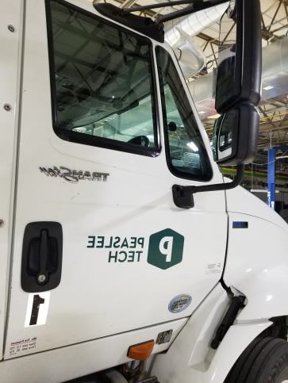
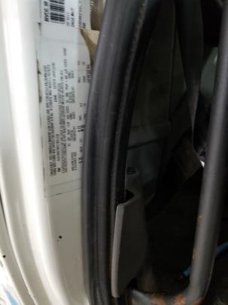
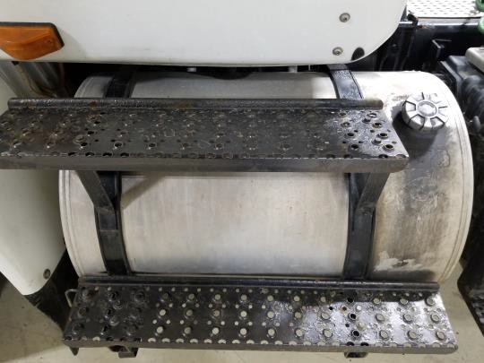
Pre-Trip Inspection
This inspection is from the front of the driver’s door to the
end of the tractor. Pointing at the items say these phrases
THE MIRROR BRACKET IS SECURELY MOUNTED AND NOT BROKEN OR DAMAGED
THE TURN SIGNAL MARKER LIGHT IS THE PROPER COLOR, YELLOW OR AMBER, AND NOT CRACKED, BROKEN, OR DIRTY
THE DOOR OPENS AND CLOSES PROPERLY. THE HINGES ARE NOT
BROKEN OR BENT. THE SEAL IS IN PLACE AND NOT DAMAGED
THE FUEL TANK IS SECURELY MOUNTED, WITH RUBBER FUEL TANK STRAP LINER AND NOT LEAKING. THE CAP IS TIGHT, SEAL INTACT, AND THE CHAIN IS PRESENT

Slide 25
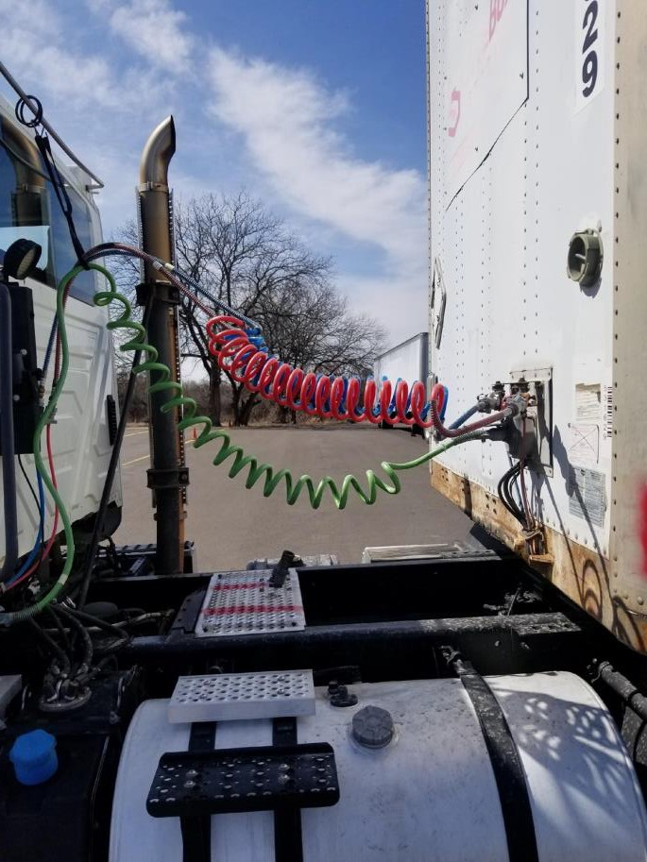
Connections
This inspection is between the cab and the trailer.
Point to, or touch, every item that you are inspecting. Tell the tester how you know that the part you are inspecting is in good, safe working condition. Identify all defects or you may not receive credit. Say exactly the words as written below.
Air/Electric Lines.
AT BOTH ENDS, THE AIR CONNECTIONS ARE PROPERLY ATTACHED AND NOT DAMAGED
AT BOTH ENDS, THE ELECTRICAL LINE IS LOCKED IN PLACE WITH THE SAFETY LATCH. THE AIR AND ELECTRICAL LINES ARE NOT LEAKING, CUT, OR SPLIT. THEY ARE NOT TANGLED OR DRAGGING ON THE CATWALK
THE SPRING TIE BACK IS IN PLACE AND HOLDING CONNECTION LINES OFF CATWALK

Slide 26
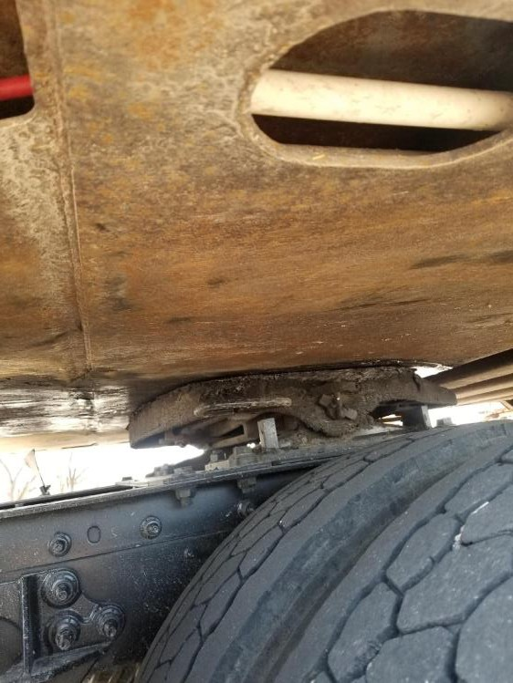
Connections
This inspection is under the front of the trailer.
Fifth Wheel Assembly.
THE TRAILER APRON HAS NO CRACKS OR BREAKS AND IS NOT BENT
THERE IS NO GAP BETWEEN THE APRON AND THE SKID PLATE. THE SKID PLATE IS PROPERLY GREASED.
THE SKID PLATE IS SECURELY MOUNTED TO THE PLATFORM. IT IS NOT CRACKED OR BENT AND IS MISSING NO HARDWARE
THE PLATFORM IS SECURELY MOUNTED TO THE FRAME AND HAS NO MISSING OR BROKEN BOLTS

Slide 27
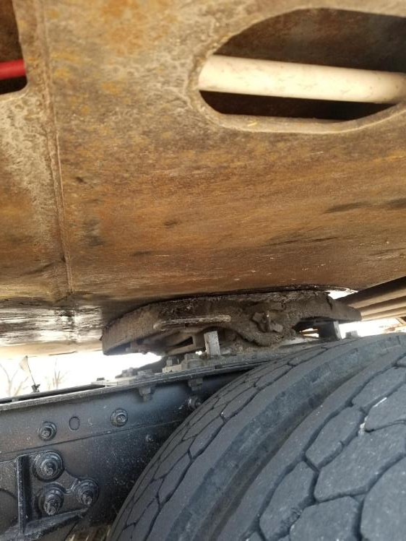
Connections (continued)
This inspection is under the front of the trailer.
Fifth Wheel Assembly.
THE RELEASE HANDLE IS IN AND THE SAFETY LATCH IS IN PLACE. THE HANDLE IS NOT DAMAGED
THE SLIDING FIFTH WHEEL LOCKING PINS ARE IN PLACE AND NOT DAMAGED. THERE IS NO MISSING HARDWARE AND NO AIR LEAKS FROM THE HOSE, AIR ACCUATER IS NOT LEAKING AND LOCKING PINS ARE IN PLACE
THE LOCKING JAWS ARE AROUND THE KINGPIN AND NEITHER ARE CRACKED OR DAMAGED
PIVOT PIN AND COTTER PIN ARE IN PLACE AND NOT CRACKED OR DAMAGED

Slide 28
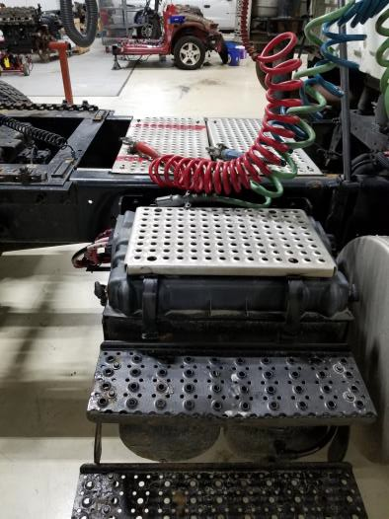
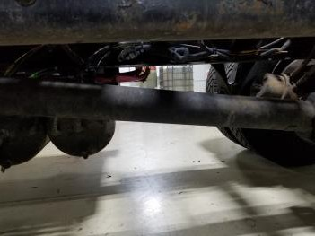
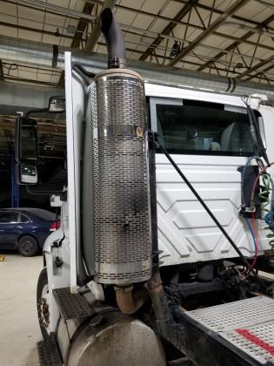
Pre-Trip Inspection
This inspection is from the front of the driver’s door to the
end of the tractor. Pointing at the items say these phrases
THE FRAME IS NOT BENT OR TWISTED AND THERE ARE NO ILLEGAL WELDS

Slide 29
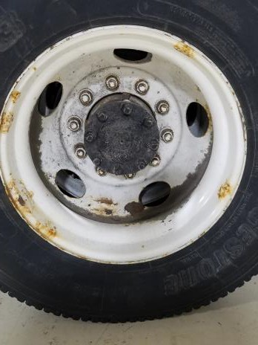
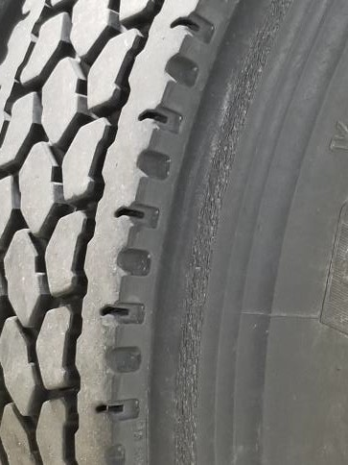
Pre-Trip Inspection
This inspection is from the front of the driver’s door to the
end of the tractor. Pointing at the items say these phrases
THE WHEEL IS NOT DAMAGED, CRACKED, OR BENT INSIDE OR OUTSIDE. THERE ARE NO WELDS
CHECK FOR PROPER TIRE INFLATION WITH AN AIR GAUGE
THE TIRE SIDEWALLS HAVE NO SPLITS OR CUTS AND THE TREAD IS EVENLY WORN
THE TIRE TREAD DEPTH OF AT LEAST 2/32”

Slide 30
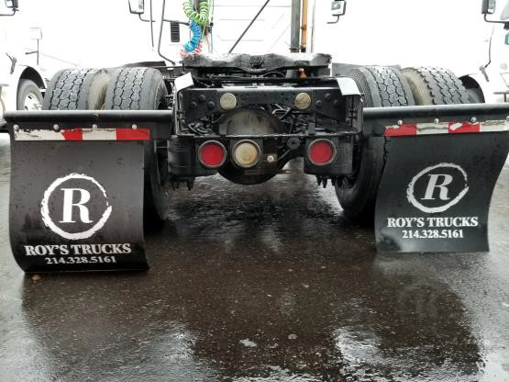
Pre-Trip Inspection
This inspection is from the front of the driver’s door to the
end of the tractor. Pointing at the items say these phrases
THE TAILLIGHTS ARE THE PROPER COLOR, RED, AND ARE NOT CRACKED, BROKEN, OR DIRTY
THE DOT TAPE IS SECURELY MOUNTED, AND IS NOT DIRTY AND COVERS 100% OF THE REAR OF THE VEHICLE
  THE MUD FLAP SUPPORT IS SECURELY MOUNTED AND THE MUD FLAP IS
NOT DAMAGED
  THERE IS ENOUGH SPACE BETWEEN THE REAR OF THE TRUCK AND THE LANDING GEAR FOR TURNS
THE LICENSE PLATE BULB IS PROPERLY INSTALLED

Slide 31
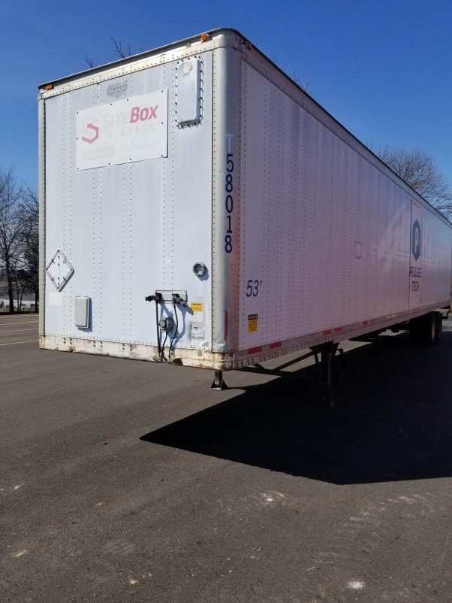
Pre-Trip Inspection
This inspection is from the front of the trailer to the back of the trailer down the driver’s side. Pointing at the items say these phrases
THE CLEARANCE LIGHTS ARE THE PROPER COLOR, YELLOW OR AMBER, AND NOT CRACKED, BROKEN, OR DIRTY
THE BULKHEAD IS NOT BENT, HAS NO HOLES, AND NO UNREPAIRED
DAMAGE. ALL HARDWARE IS PRESENT
THE SIDE OF THE TRAILER HAS NO HOLES AND NO RIVETS MISSING

Slide 32
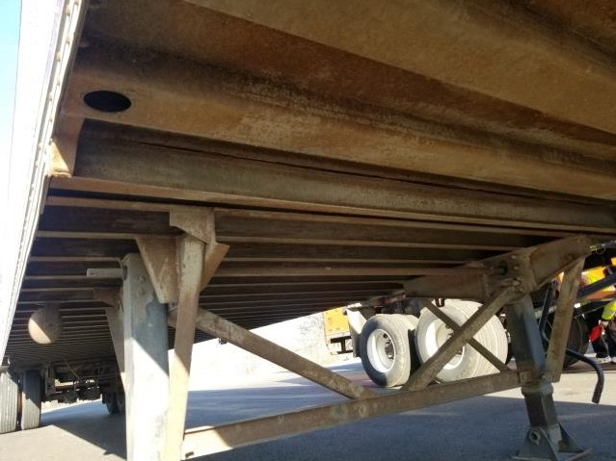
Pre-Trip Inspection
This inspection is from the front of the trailer to the back of the trailer down the driver’s side. Pointing at the items say these phrases
THE FRAME AND CROSS MEMBER ARE NOT BENT OR TWISTED. THERE ARE NO CRACKS OR ILLEGAL WELDS
THE FLOOR IS SECURELY MOUNTED AND HAS NO HOLES
THE LANDING GEAR IS SECURELY MOUNTED, NOT DAMAGED, AND ALL HARDWARE IS PRESENT. THE HANDLE IS UP, SECURE AND OPERATIONAL

Slide 33

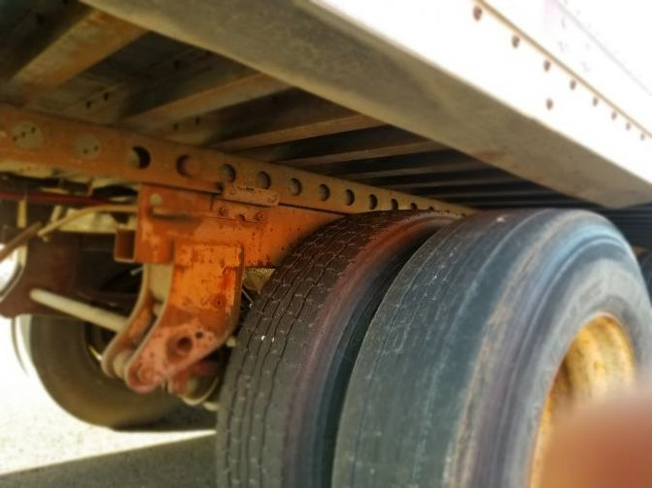
Pre-Trip Inspection
This inspection is from the front of the trailer to the back of the trailer down the driver’s side. Pointing at the items say these phrases
THE LIGHTS ON THE SIDE OF THE TRAILER ARE THE PROPER COLOR, YELLOW OR AMBER, AND NOT CRACKED, BROKEN, OR DIRTY
THE TANDEM RELEASE ARM AND LOCKING PINS ARE NOT DAMAGED.
THE RELEASE ARM IS LOCKED AND PINS IN PLACE.

Slide 34
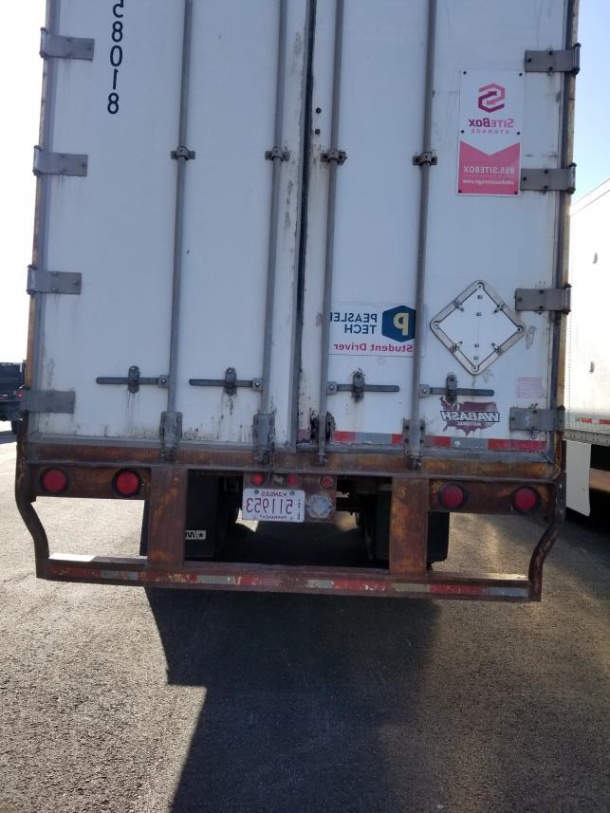
Pre-Trip Inspection
This inspection is from the front of the trailer to the back of the trailer down the driver’s side. Pointing at the items say these phrases
THE LIGHTS ARE THE PROPER COLOR, RED, AND ARE NOT CRACKED, BROKEN, OR DIRTY
THE DOT TAPE IS SECURELY MOUNTED, IS NOT DIRTY, AND COVERS 100% OF THE REAR OF THE TRAILER
I WILL CHECK THE PASSENGER SIDE IN THE SAME MANNER
9

